Slide 1
Chapter Outline
Network layer design issues
Routing algorithms
Congestion control algorithms
Internetworking
IP
IP addresses
Network layer protocols
  ARP
  IP_{v}4
  ICMP
  IP_{v}6
Routing protocols
  OSPF
  BGP
1

Slide 2

Outline
Store-and-Forward Packet Switching
Services Provided to the Transport Layer
Implementation of Connectionless Service
Implementation of Connection-Oriented Service
Comparison of Virtual-Circuit and Datagram Subnets

Slide 3
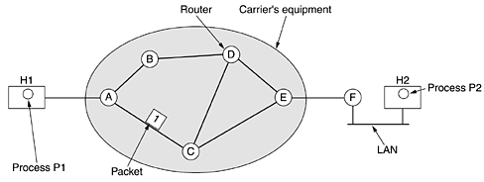

Store-and-Forward Packet Switching
The Environment of the Network Layer Protocols

Slide 4
Store-and-Forward Packet Switching
The major components of the system are the carrier's equipment (routers connected by transmission lines)
Host H1 is directly connected to one of the carrier's routers, A
H2 is on a LAN with a router, F
F is probably no different from the carrier's routers

Slide 5
Store-and-Forward Packet Switching
A host with a packet to send transmits it to the nearest router, either on its own LAN or over a point-to-point link to the carrier
The packet is stored there until it has fully arrived
Then it is forwarded to the next router along the path until it reaches the destination host

Slide 6
Services Provided to the Transport Layer
The network layer services have been designed with the following goals
  The services should be independent of the router technology
  The transport layer should be shielded from the number, type, and topology of the routers present
  The network addresses made available to the transport layer should use a uniform numbering plan, even across LANs and WANs
The network layer should provide connection-oriented service or connectionless service

Slide 7
Implementation of Connectionless Service
Packets are injected into the subnet individually and routed independently of each other
No advance setup is needed
The packets are frequently called datagram and the subnet is called a datagram subnet

Slide 8

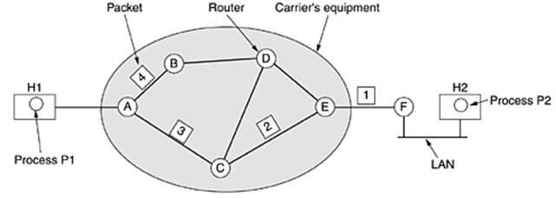
Implementation of Connectionless Service
Routing within a datagram subnet

Slide 9
Implementation of Connectionless Service
Let us now see how a datagram subnet works
Suppose that the process P1 in has a long message for P2
The network layer has to break it into four packets, 1, 2, 3, and 4 and sends each of them in turn to router A
Every router has an internal table telling it where to send packets for each possible destination

Slide 10
Implementation of Connectionless Service
As they arrived at A, packets 1, 2, and 3 were stored
Then each was forwarded to C
Packet 1 was then forwarded to E and then to F
When it got to F, it was encapsulated in a data link layer frame and sent to H2 over the LAN

Slide 11
Implementation of Connection-Oriented Service
A path from the source to the destination must be established before any data packets can be sent
In analogy with the physical circuits set up by the telephone system
This connection is called a VC (virtual circuit)
The subnet is called a virtual-circuit subnet
For connection-oriented service, we need a virtual-circuit subnet

Slide 12
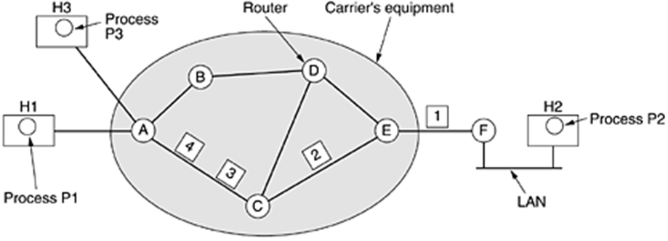
Implementation of Connection-Oriented Service
Routing within a virtual-circuit subnet

Slide 13
Implementation of Connection-Oriented Service
The idea behind virtual circuits is to avoid having to choose a new route for every packet sent
when a connection is established…
  A route from the source to the destination is chosen as part of the connection setup and stored in tables inside the routers
When the connection is released, the virtual circuit is also terminated

Slide 14
Implementation of Connection-Oriented Service
If H3 also wants to establish a connection to H2
It chooses connection identifier 1 and tells the subnet to establish the virtual circuit
To avoid conflict, A assigns a different connection identifier to the outgoing traffic for the second connection

Slide 15
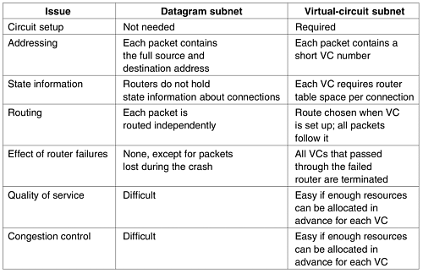
Comparison of Virtual-Circuit and Datagram Subnets

Slide 16
Routing Algorithms
It is that part of the network layer software responsible for deciding which output line an incoming packet should be transmitted on
It can be grouped into two major classes
  Nonadaptive
    It does not base their routing decisions on measurements or estimates of the current traffic and topology
    This procedure is sometimes called static routing
  Adaptive
    It changes their routing decisions to reflect changes in the topology, and usually the traffic as well

Slide 17
Outline
Properties
Shortest Path Routing
Flooding
Distance Vector Routing
Link State routing
Hierarchical routing
Broadcast routing
Multicast routing
Routing for mobile hosts
Routing in Ad Hoc Networks
Node Lookup in Peer-to-Peer Networks

Slide 18
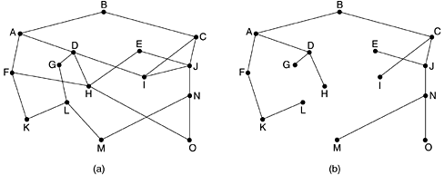
The Optimality Principle
A general statement about optimal routes without regard to network topology or traffic
This statement is known as the optimality principle
If router J is on the optimal path from router I to router K, then the optimal path from J to K also falls along the same route.
(a) A subnet. (b) A sink tree for router B.

Slide 19
Shortest Path Routing
Shortest Path Routing is simple and easy to understand
The idea is to build a graph of the subnet, with each node of the graph representing a router and each arc of the graph representing a communication line
The concept of a shortest path deserves some explanation
One way of measuring path length is the number of hops

Slide 20
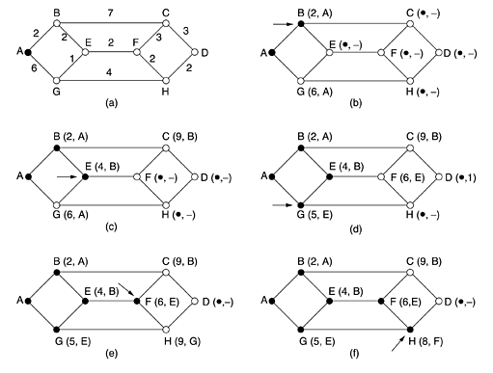
Shortest Path Routing

Slide 21
Flooding
In flooding, every incoming packet is sent out on every outgoing
It obviously generates vast numbers of duplicate packets
The flood is to keep track of which packets have been flooded, to avoid sending them out a second time
Achieve this goal is to have the source router put a sequence number in each packet it receives from its hosts

Slide 22
Distance Vector Routing
Dynamic routing algorithms
Distance vector routing algorithms operate by having each router maintain a table
These tables are updated by exchanging information with the neighbors

Slide 23
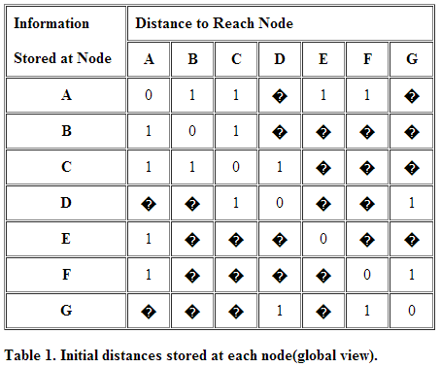
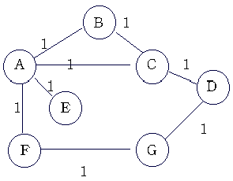
Distance Vector Routing

Slide 24
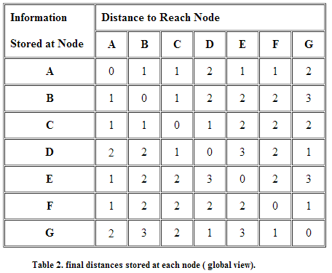
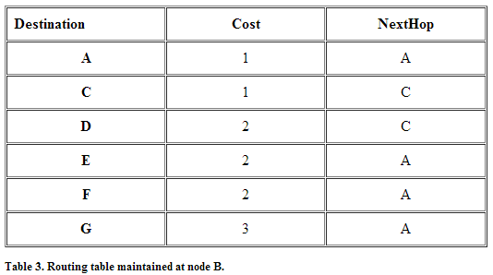
Distance Vector Routing

Slide 25
Link State Routing
In distance vector routing, two primary problems caused its demise
  Since the delay metric was queue length, it did not take line bandwidth into account when choosing routes
  The count-to-infinity problem

Slide 26
Link State Routing
The idea behind link state routing is simple and can be stated as five parts
  Discover its neighbors and learn their network addresses
  Measure the delay or cost to each of its neighbors
  Construct a packet telling all it has just learned
  Send this packet to all other routers
  Compute the shortest path to every other router

Slide 27
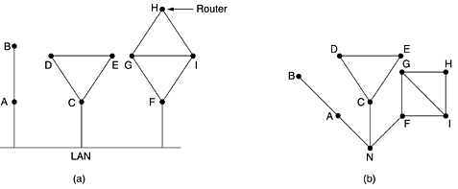
Learning about the Neighbors
When a router is booted, its first task is to learn who its neighbors are
It accomplishes this goal by sending a special HELLO packet on each point-to-point line
When two or more routers are connected by a LAN, the situation is slightly more complicated
One way to model the LAN is to consider it as a node itself

Slide 28
Measuring Line Cost
Measuring line cost to each of its neighbors
  Round-trip time of HELLO packet
  Traffic load
  Line bandwidth

Slide 29
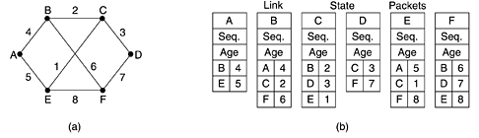
Building Link State Packets
Packet Format
  Identity of Sender
  Sequence Number
  Age
  List of Neighbors
  Corresponding Delay

Slide 30
Building Link State Packets
Building the link state packets is easy
The hard part is determining when to build them
One possibility is to build them periodically, that is, at regular intervals
Another possibility is to build them when some significant event occurs, such as a line or neighbor going down or coming back up again or changing its properties appreciably

Slide 31

Distributing the Link State Packets
Trickiest part of algorithm
  Arrival time for packets different
  How to keep consistent routing tables
Basic algorithm
  Sequence number (in each packet) to limit duplicates
  Flooding +
    If new then it is broadcasted to all neighboring routers
    If duplicate, it is disregarded.
    If sequence number is lower than the highest one, it is rejected.

Slide 32
Distributing the Link State Packets
Problems with basic algorithm
  Wrap around of sequence numbers
  Make a long precision number (e.g., 32-bit)
  Wrong sequence number used
    Lost in case of crash
    Corruption
Solution: Include Age of each packet
  Decrement this value once per second
  When zero, this state information is disregarded

Slide 33
Distributing the Link State Packets
Refinements
  Link state packets are not forwarded immediately
  During holding time
    Duplicates are discarded
    Old packets are thrown out

Slide 34
Computing the New Routes
Computing new routes
  With a full set of link state packets, a router can
    Construct the entire subnet graph
    Run Dijkstra’s algorithm to compute the shortest path to each destination
  Problems for large subnets
    Memory to store data
    Compute time

Slide 35
Computing the New Routes
Usage
  IS-IS protocol
    Designed for DECnet, adopted by ISO
    In use also in Internet
    Supports multiple network layer protocols
  OSPF protocol used in Internet
  Common features
    Self-stabilizing method of flooding link state updates
    Concept of a designated router on a LAN
    Method of computing and supporting path splitting and multiple metrics

Slide 36
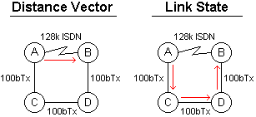
A Comparison: Link State vs. Distance Vector
If all routers were running a Distance Vector protocol, the route chosen would be from A to B directly over the ISDN serial link, even though that link is about 10 times slower than the indirect route from A C D B
A Link State protocol would choose the A C D B path because it's using a faster medium (100 Mb ethernet)
In this example, it would be better to run a Link State routing protocol, but if all the links in the network are the same speed, then a Distance Vector protocol is better

Slide 37
Hierarchical Routing
When network size increases…
  Proportionally large routing tables are required for each router
  More CPU time is needed to scan them
  More bandwidth is needed to send status reports
  Solution: Routing has to be done hierarchically

Slide 38
Hierarchical Routing
Routers divided in Regions (as in telephone network)
  Each router knows how to route packets to destinations within its own region
  However, router does not have any information regarding the topology of the network of other regions
  When different networks are interconnected they are regarded as a separate region
  Huge networks will require more than two-level hierarchy

Slide 39
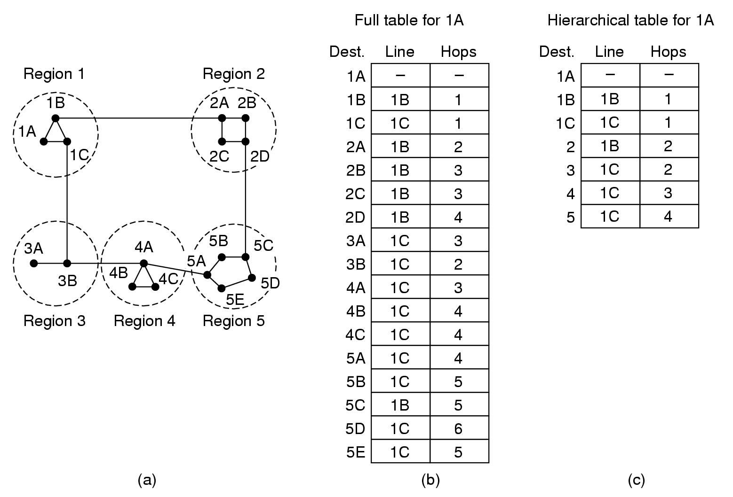
Hierarchical Routing

Slide 40
Broadcast Routing
Sending a packed to all destinations simultaneously is called Broadcasting
There are a number of methods for broadcasting
  Send a distinct packet to each destination
  Flooding
  Multidestination routing
  Using a spanning tree
  Reverse path forwarding

Slide 41
Broadcast Routing
Send a distinct packet to each destination
  This is a very simple method, in which a source sends a distinct packet to each destination
    Major disadvantages of this method are
      It wastes bandwidth
      In this method source needs to have a complete list of all destinations
  Because of this reason this method is the least desirable of the other methods

Slide 42
Broadcast Routing
Flooding
  In this method, every incoming packet is sent out on every outgoing line except the line from which it arrived
    Major disadvantage
      It generates lots of redundant packets
      Consumes too much bandwidth

Slide 43
Broadcast Routing
Multidestination routing
  Each packets contains
    A list of destination
    A bit map indicating the desired destinations
  When packet arrives at a router
    The router checks all the destinations to determine the set of output lines that will be needed
    Generates a new copy of the packed for each output line to be used and includes in each packet only those destinations that are to use the line

Slide 44
Broadcast Routing
Using a spanning tree
  A spanning tree is a subset of graph that includes all the nodes but contains no loops
  When a packet arrives at a router, it copies onto all the spanning tree lines except the one it arrived on
Advantage
  It makes excellent use of bandwidth and generates only the minimum number of packets required to do the job
Disadvantage
  Each router must have knowledge of some spanning tree. Sometimes this information is available but sometimes it is not

Slide 45
Broadcast Routing
Reverse path forwarding
  Use When knowledge of a spanning tree is not available
  Provides an approximation of spanning tree routing
  Routers check to see if incoming packet arrives from the same line that the router uses to route outgoing packets to the broadcast source
    If so, the router duplicates the packet on all other outgoing lines
    Otherwise, the router discards the packet

Slide 46
Multicast Routing
  Some applications require that widely-separated processes work together in groups
    Small group can use point-to-point messaging to accomplish this task
    If the group is large is inefficient because most receivers are not interested in the message
  Need a mechanism that would send messages to well-defined groups
    Sending a message to a such a group is called multicasting
    Corresponding routing algorithm is called multicast routing

Slide 47
Multicast Routing
Requirements
  Create and Destroy Groups
  Nodes should be able to Join and Leave Groups
  When a process joins a group it informs its host
  Routers must know which of their hosts belong to which group
    Host must inform their routers about changes in group membership, or
    Routers must query their hosts periodically
  Information shared with Neighboring Routers

Slide 48
Multicast Routing
Pruning spanning tree
  Reverse path forwarding
  Router with no hosts interested in a particular group sends a PRUNE message
  The subnet is recursively pruned
  Disadvantage of algorithm
  suppose that network has n groups, each with an average of m members
  For each group, m pruned spanning trees must be stored
  Total of mn trees

Slide 49
Routing for Mobile Hosts
Stationary Hosts
  Hosts that never move
  It is connected to the network by copper wires or fiber optics
Migratory Hosts
  Stationary hosts who move from one fixed site to another from time to time but use the network only when they are connected
Roaming Hosts
  Need to maintain their connections as they move around
Mobile Hosts
  Migratory and Roaming Hosts – that is all host that are away from home and still want to be connected

Slide 50
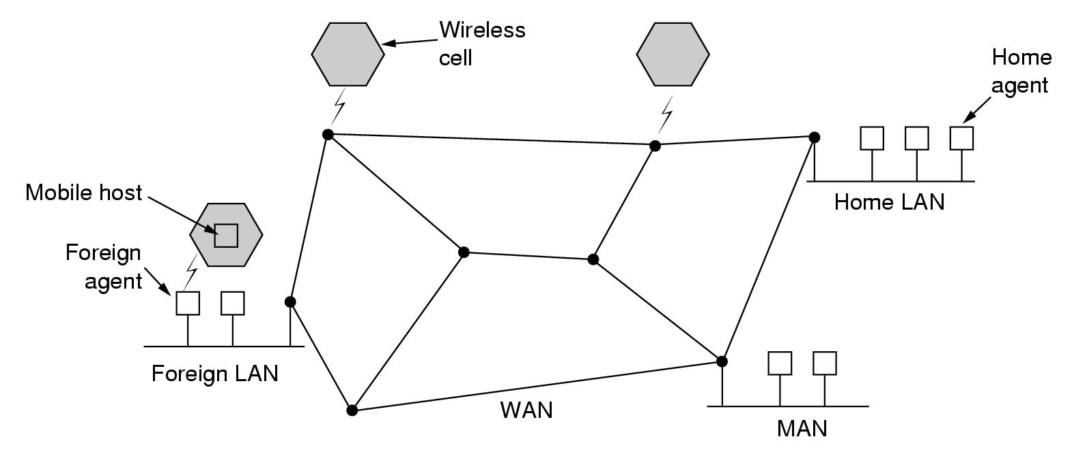
Routing for Mobile Hosts
A WAN to which LANs, MANs, and wireless cells are attached

Slide 51
Routing for Mobile Hosts
All hosts are assumed to have
  A permanent home location
  A permanent home address
Routing goal in systems with mobile hosts
  To make possible to send packets to mobile hosts using their home address
  The packets efficiently reach them wherever they may be

Slide 52
Routing for Mobile Hosts
  Each area has one or more
    Foreign agents
      Processes that keep track of all mobile hosts visiting the area
    Home agent
      Keeps track of hosts whose home is in the area, but who are currently visiting another area

Slide 53
Routing for Mobile Hosts
How does it work?
  Registration procedure with foreign agents
  Sending packets
  Leaving an area

Slide 54
Routing for Mobile Hosts
Registration procedure with foreign agent
  Announcing existence of foreign agent
    Broadcast by foreign agent
    Broadcast query by arriving mobile user
  Mobile host register with foreign agent and giving it
    Home address
    Current data link address
    Security information

Slide 55
Routing for Mobile Hosts
  Foreign agent contacts home agent of user
    Identity of user
    Security info
    Network address of foreign agent
  Home agent
    Checks security info
      Which contains a timestamp, to prove that it was generated within the past few seconds
    Sends ack to foreign agent
  Foreign agent
    When the foreign agent gets the acknowledgement from the home agent
    It makes an entry in its tables and informs the mobile host that it is now registered

Slide 56
Routing for Mobile Hosts
Sending a packet to a mobile user
  Home address is used ➔ packet routed to home LAN
  Packet intercepted by home agent
   address of user ≠ address of home agent!
  Packet forwarded to the foreign agent
    Encapsulation – tunneling
  Foreign agent forwards packet to mobile user
    Which protocol, address used?
  Sender is given address of foreign agent
    Encapsulation – tunneling used, required?

Slide 57
Routing for Mobile Hosts
Leaving an area
  Announced by user ➔ deregistration
  Automatic detection by foreign agent

Slide 58
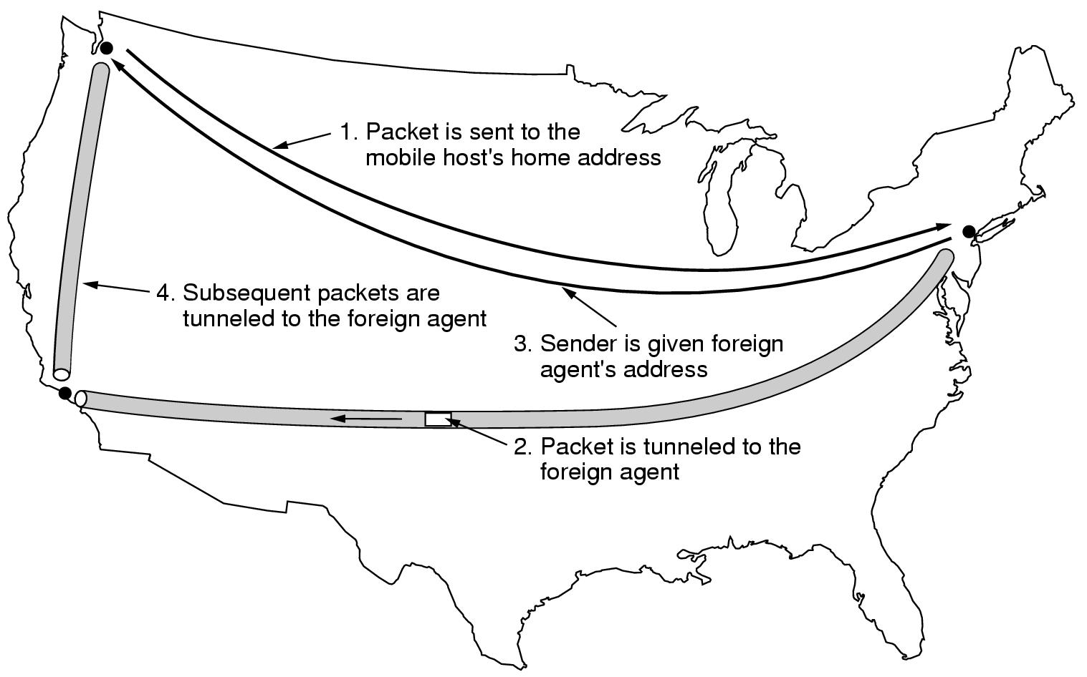
Routing for Mobile Hosts
Home agent
Foreign agent

Slide 59
Routing in Ad Hoc Networks
Ad Hoc Network = routers are mobile
  No fixed topologies
  No fixed or known neighbours
  Valid paths can disappear at any time
  Node = router + host
  Routing quite different from routing in wired networks
Examples
  Military vehicles on a battlefield
  Fleet of ships at see
  People with notebooks (lacking 802.11)
  Emergency workers at an earthquake

Slide 60
Routing in Ad Hoc Networks
A variety of routing algorithms for ad hoc networks have been proposed
One of the more interesting ones is the AODV routing algorithm
AODV = Ad hoc On-demand distance vector routing
  On-demand: route computed when needed
  Distance vector for mobile world
  Taking into account limited bandwidth + low battery life

Slide 61
Routing in Ad Hoc Networks
Graph presentation
  Node
  Arc=Two nodes are connected if they can communicate directly using their radios
  For simplicity connection is assumed symmetric
Routing table
  Line for known routes
  Can be valid or invalid
A wants to send a packet
  Start route discovery and broadcasting a route request packet
Dest | Next hop | Distance | Other fields
B | B | 1 | …
C | B | 2 | …
H | D | 3 | …

Slide 62
Routing in Ad Hoc Networks
Route request packet
  Source & destination address: e.g. IP address
  Request ID
    Local counter incremented for each new route request packet broadcasted
    Allows to discard duplicate requests at other nodes
  Source sequence #
    Counter to distinguish old routes to destination from new ones
  Destination sequence #
    Most recent sequence counter of destination seen by source

Slide 63
Routing in Ad Hoc Networks
Range of A’s Broadcast
A
A
A
A
B
C
B
C
B
C
B
C
D
D
D
D
E
E
E
E
F
G
F
G
F
G
F
G
H
I
H
I
H
I
H
I
Range of A’s Broadcast
After B and D have received of A’s Broadcast
After C,F and G have received of A’s Broadcast
After E,H and I have received of A’s Broadcast

Slide 64
Routing in Ad Hoc Networks
Processing a route request packet
  Duplicate request?
    Yes: discard
  Fresh route to destination known?
    Fresh = local destination sequence # >= destination sequence # in request
    Yes: send route reply packet
  No fresh route to destination is known!
    Store info from route request in reverse route table; to enable the forwarding of route reply packets
    Increment hop count
    Rebroadcast route request

Slide 65
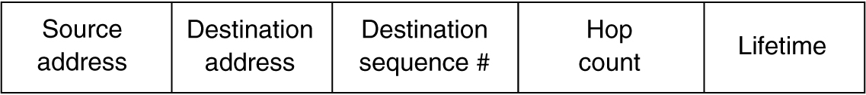
Routing in Ad Hoc Networks
Route reply packet
  Returned by
    Intermediate node knowing a fresh route
    Destination node
Destination sequence#
  Number known by sender of reply packet
Hop count
  Set to length of path known by sender of reply packet
  For destination = 0

Slide 66
Routing in Ad Hoc Networks
At each intermediate node the packed is inspected and entered into local routing table when
  No route to destination is known
  Sequence number for destination in REPLY is greater than the value in the routing table
  Sequence number is equal but the new route is shorter
The discovery process is then modified as follows
  To locate a destination, the sender broadcasts a ROUTE REQUEST packet with Time to live set to 1
  If no response comes back within a reasonable time, another one is sent, this time with Time to live set to 2

Slide 67
Routing in Ad Hoc Networks
Route maintenance
  Detect that neighbours are not reachable anymore
    Broadcast Hello packet periodically
    Failure to send packet
  Cleanup routing table
  Additional field in routing table: active neighbour
    Nodes that have offered path to destination in recent past

Slide 68
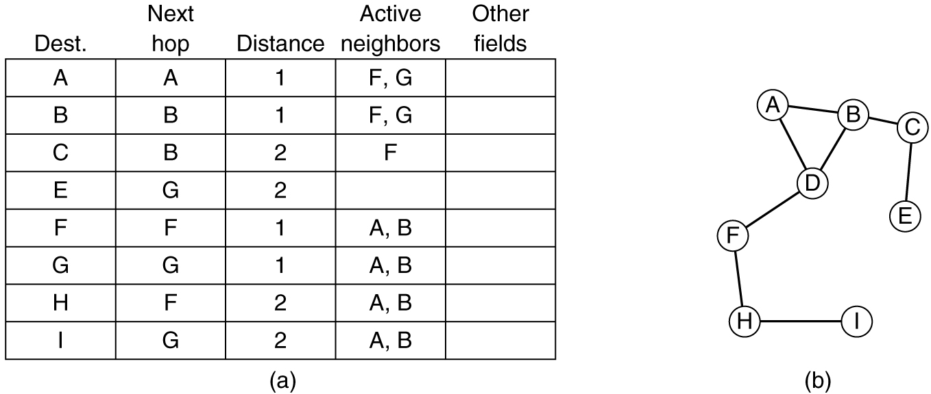
Routing in Ad Hoc Networks
Route maintenance
  Routing table of D
G
Node G goes down!

Slide 69
Routing in Ad Hoc Networks
Route maintenance
  New routing table of D
    Delete routes with G as next hop
    Delete G as active neighbour

Slide 70
Node Lookup in Peer-to-Peer Networks
One of p2p routing algorithm—Chord
The Chord system consists of n participating users
Each user node has an IP address that can be hashed to an m-bit number call node identifier
Chord uses SHA-1 for hash
SHA-1 is used in cryptography

Slide 71
Node Lookup in Peer-to-Peer Networks
Successor (k) is the node identifier of the first actual node following k around the circle clockwise.
To greatly speed up the search, each node also maintains a table calls a finger table
Each of the entries has two fields: start and the IP address of successor(start)

Slide 72
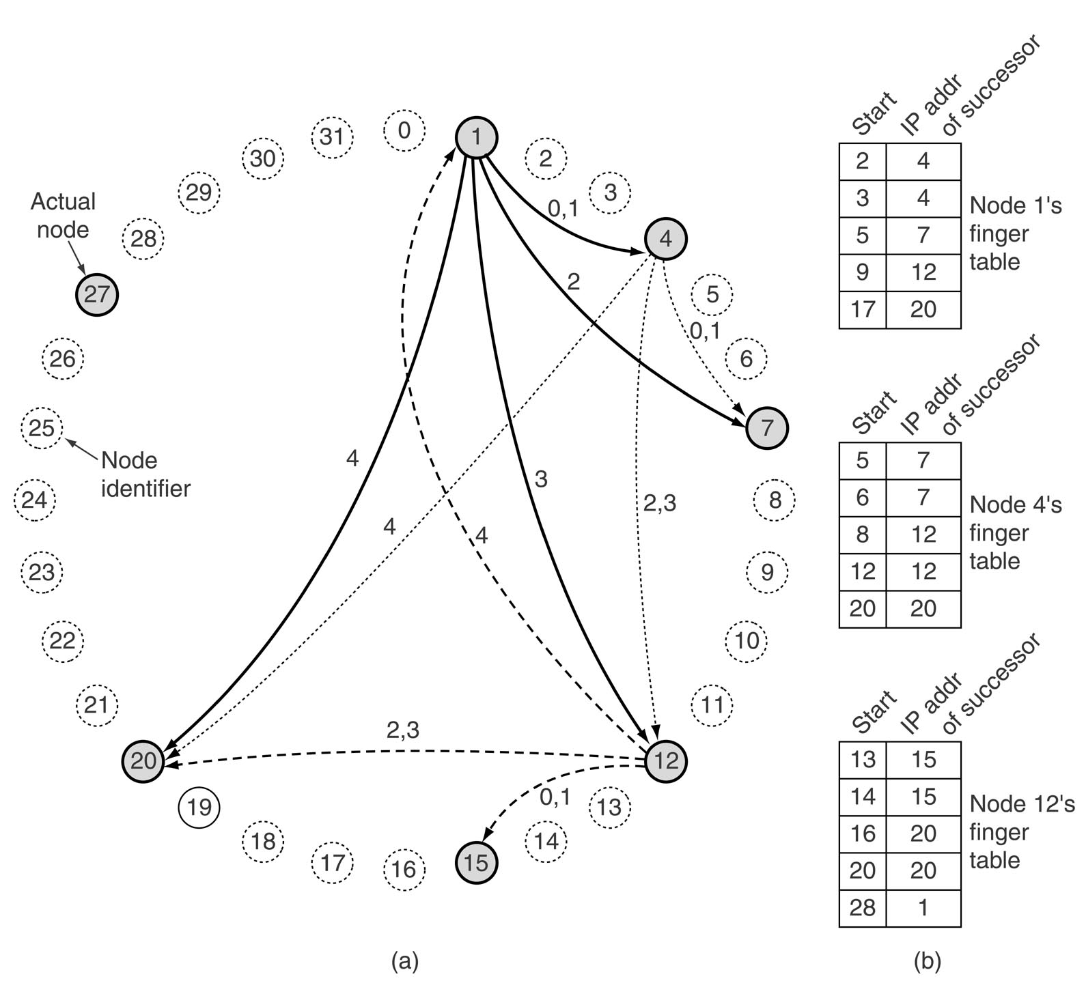
Node Lookup in Peer-to-Peer Networks

Slide 73
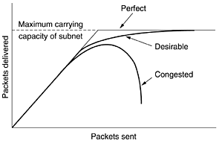
Congestion Control
When too many packets are present in the subnet, performance degrades
This situation is called congestion

Slide 74
Congestion Control
Congestion can be brought on by several factors
  Insufficient memory
  Slow processors
  Low-bandwidth lines
Flow control, in contrast, relates to the point-to-point traffic between a given sender and a given receiver

Slide 75
Outline
General Principles of Congestion Control
Congestion Prevention Policies
Congestion Control in Virtual-Circuit Subnets
Congestion Control in Datagram Subnets

Slide 76
General Principles of Congestion Control
Dividing all solutions into two groups
  Open loop solution
    Attempt to solve the problem by good design.
    It makes decisions without regard to the current state of network
  Closed loop solution based on the concept of a feedback loop
    Monitor the system
      To detect when and where congestion occurs
    Pass information
      To where action can be taken
    Adjust system operation
      To correct the problem

Slide 77
General Principles of Congestion Control
A variety of metrics can be used to monitor the subnet for congestion
  Lack of buffer space
  The average queue lengths
  The number of packets that time out and are retransmitted
  The average packet delay
  The standard deviation of packet delay

Slide 78
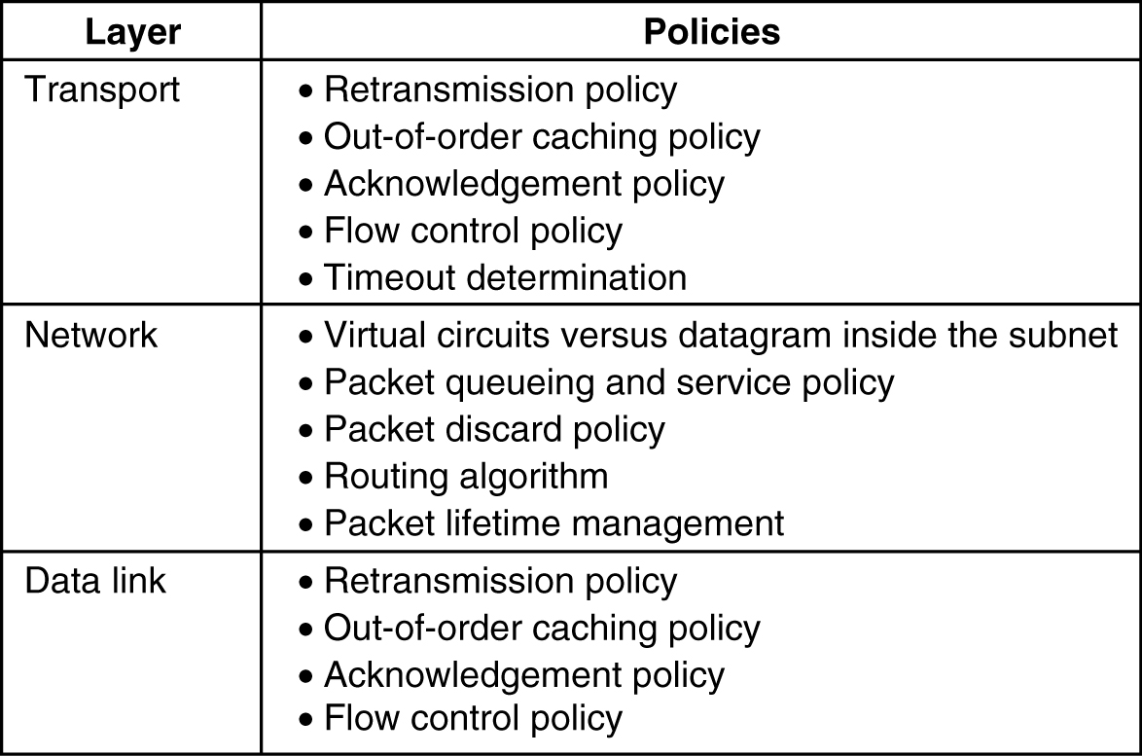
Congestion Prevention Policies
Policies that affect congestion

Slide 79
Congestion Control in Virtual-Circuit Subnets
Admission control technique
  Once congestion has been signalled, no more virtual circuits are setup until the problem has gone away
An alternative approach is to allow new virtual circuits but carefully route all new virtual circuits around problem areas

Slide 80
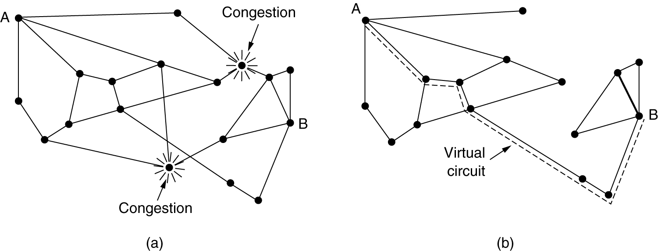
Congestion Control in Virtual-Circuit Subnets
(a) A congested subnet. (b) A redrawn subnet that eliminates the congestion. A virtual circuit from A to B is also shown

Slide 81
Congestion Control in Virtual-Circuit Subnets
Another strategy relating to virtual circuits is to negotiate an agreement between the host and subnet when a virtual circuit is set up
The agreement specifies the volume the shape of the traffic, Qos etc
To keep part of the agreement, the subnet, the subnet will typically reserve resources along the path when the circuit is set up

Slide 82
Congestion Control in Datagram Subnets
Each router can easily monitor the utilization of its output lines and other resources
        For example, u_{new}=a*u_{old}+(1-a)f
        u=a real variable, a=0.0-1.0, f=0 or 1
Whenever u moves above the threshold, the output line enters a ''warning'' state
Each newly-arriving packet is checked to see if its output line is in warning state
If it is, some action is taken
The action taken can be one of several alternatives, which we will now discuss

Slide 83
The Warning Bit
The warning state is set as a special bit in the packet’s header
As long as the router was in the warning state, the source continued to get acknowledgements with it
As long as the warning bits continued to flow in, the source continued to decrease its transmission rate

Slide 84
Choke Packets
In the warning state, the router sends a choke packet back to the source host
When the source host gets the choke packet. It reduce the traffic by x%
It ignore choke packets referring to the destination for a fixed time interval, and check again if there is still the choke packets sent back.

Slide 85
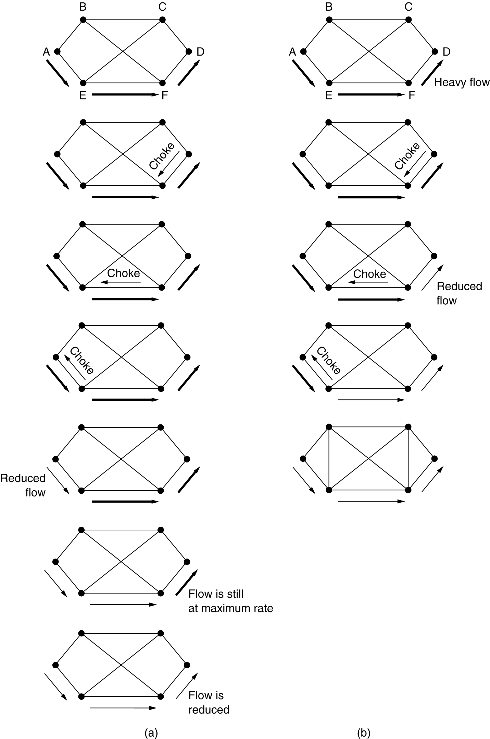
Choke Packets
A choke packet that affects only the source
A choke packet that affects each hop it passes through
The net effect of this hop-by hop scheme is to provide quick relief at the point of congestion at the price of using up more buffers upstream
In this way, congestion can be nipped in the bud without losing any packets

Slide 86
Internetworking
The physical and data link layers operate locally
These two layers are jointly responsible for data delivery on the network from one node to the next

Slide 87

Internetworking (Links between two hosts)

Slide 88
Chapter Outline
Need for Network Layer
Internet as a Datagram Network
Internet as a Connectionless Network

Slide 89
Need for Network Layer
To solve the problem of delivery through several links, the network layer was designed
The network layer is responsible for host-to-host delivery and for routing the packets through the routers

Slide 90

Need for Network Layer

Slide 91
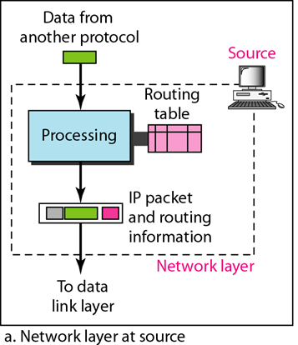
Need for Network Layer

Slide 92
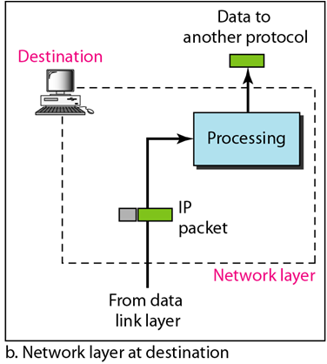
Need for Network Layer

Slide 93

Need for Network Layer

Slide 94
Internet as a Datagram Network
The Internet, at the network layer, is a packet-switched network
The Internet has chosen the datagram approach to switching in the network layer
It uses the universal addresses defined in the network layer to route packets from the source to the destination

Slide 95
Internet as a Connectionless Network
In connection-less service, the network layer protocol treats each packet independently
The packets in a message may or may not travel the same path to their destination
This type of service is used in the datagram approach to packet switching
The Internet has chosen this type of service at the network layer

Slide 96
IP Protocol
An IP datagram consists of a header part and a text part
The header has a 20-byte fixed part and a variable length optional part

Slide 97
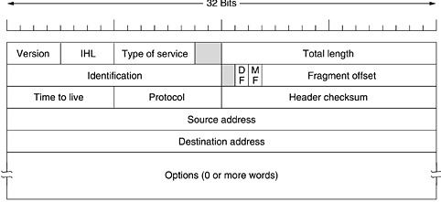
IP Protocol

Slide 98
IP Protocol
Version: It keeps track of which version of the protocol the datagram belongs to
IHL: It is provided to tell how long the header is, in 32-bit words
  The minimum value is 5 and maximum value is 15
Type of service: It is intended to distinguish between different classes of service
Total length: It includes both header and data
  The maximum length is 65,535 bytes

Slide 99
IP Protocol
DF: IT stands for Don't Fragment
  It is an order to the routers not to fragment the datagram
MF: It stands for More Fragments
  It is needed to know when all fragments of a datagram have arrived
Fragment offset: It tells where in the current datagram this fragment belongs
  There is a maximum of 8192 fragments per datagram
Time to live: It is a counter used to limit packet lifetimes
  It is supposed to count time in seconds, allowing a maximum lifetime of 255 sec and it must be decremented on each hop

Slide 100
IP Protocol
Protocol field: It tells to network layer which transport process to give it
  TCP is one possibility
Header checksum: It verifies the header only
  Such a checksum is useful for detecting errors generated by bad memory words inside a router
The Source address and Destination address indicate the network number and host number

Slide 101
IP Address
Every host and router on the Internet has an IP address, which encodes its network number and host number
The combination is unique: in principle, no two machines on the Internet have the same IP address
IP addresses are 32 bits long and are used in the Source address and Destination address fields of IP packets

Slide 102
IP Address
An IP address does not actually refer to a host
It really refers to a network interface, so if a host is on two networks, it must have two IP addresses
However, in practice, most hosts are on one network and thus have one IP address

Slide 103
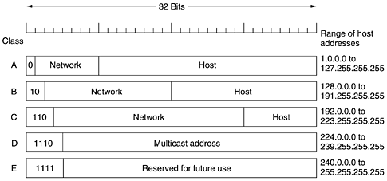
IP Address

Slide 104
IP Address
The class A, B, C, and D formats allow for up to 128 networks with 16 million hosts each
Network addresses, which are 32-bit numbers, are usually written in dotted decimal notation
In this format, each of the 4 bytes is written in decimal, from 0 to 255
For example, the 32-bit hexadecimal address C0290614 is written as 192.41.6.20
The lowest IP address is 0.0.0.0 and the highest is 255.255.255.255

Slide 105
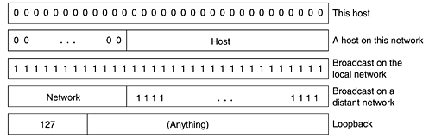
IP Address (Special)

Slide 106
IP Address
The values 0 and -1 (all 1s) have special meanings
The value 0 means this network or this host. The value of -1 is used as a broadcast address
The IP address 0.0.0.0 is used by hosts when they are being booted
IP addresses with 0 as network number refer to the current network

Slide 107
ARP
A host or a router has an IP datagram to send to another host or router, it has the logical IP address of the receiver
The logical (IP) address is obtained from the DNS
  If the sender is the host or
  It is found in a routing table if the sender is a router
But the IP datagram must be encapsulated in a frame to be able to pass through the physical network
This means that the sender needs the physical address of the receiver

Slide 108
ARP Operation
The host or the router sends an ARP query packet
The packet includes IP addresses of the sender and receiver
Because the sender does not know the physical address of the receiver, the query is broadcast over the network
Every host or router on the network receives and processes the ARP query packet
  But only the intended recipient recognizes its IP address and sends back an ARP response packet
The response packet contains the recipient's IP and physical addresses

Slide 109

ARP Operation

Slide 110
Cache Memory
ARP is inefficient if system A needs to broadcast an ARP request for each IP packet it needs to send to system B
ARP can be useful if the ARP reply is cached because a system normally sends several packets to the same destination
A system that receives an ARP reply stores the mapping in the cache memory and keeps it for 20 to 30 minutes unless the space in the cache is exhausted
Before sending an ARP request, the system first checks its cache to see if it can find the mapping

Slide 111

ARP Packet

Slide 112
Packet Format
Hardware type: This is a 16-bit field defining the type of the network on which ARP is running
Protocol type: This is a 16-bit field defining the protocol
Hardware length: This is an 8-bit field defining the length of the physical address in bytes
Protocol length: This is an 8-bit field defining the length of the logical address in bytes
Operation: This is a 16-bit field defining the type of packet. Two packet types – 1) ARP request 2) ARP reply

Slide 113
Packet Format
Sender hardware address: This is a variable-length field defining the physical address of the sender
Sender protocol address: This is a variable-length field defining the logical address of the sender
Target hardware address: This is a variable-length field defining the physical address of the target
Target protocol address: This is a variable-length field defining the logical address of the target

Slide 114
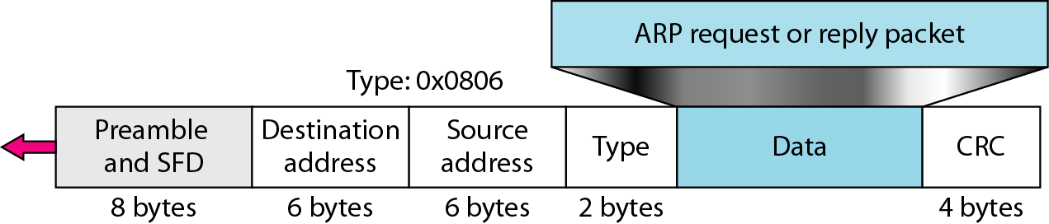
Encapsulation
An ARP packet is encapsulated directly into a data link frame
For example an ARP packet is encapsulated in an Ethernet frame
Note that the type field indicates that the data carried by the frame are an ARP packet

Slide 115

Operation

Slide 116
ProxyARP
A proxy ARP is an ARP that acts on behalf of a set of hosts
A proxy ARP receives an ARP request looking for the IP address of one of these hosts
After the router receives the actual IP packet, it sends the packet to the appropriate host or router

Slide 117

ProxyARP

Slide 118
IPv4
The Internet Protocol version 4 (IPv4) is the delivery mechanism used by the TCP/IP protocols
IPv4 is an unreliable and connectionless datagram protocol-a best-effort delivery service

Slide 119

IPv4
        Position of IPv4 in TCP/IP protocol suite

Slide 120

OutLine
Datagram
Fragmentation
Checksum
Options

Slide 121
Datagram
Packets in the IPv4 layer are called datagrams
A datagram is a variable-length packet consisting of two parts
  Header
  Data
The header is 20 to 60 bytes in length

Slide 122

Datagram

Slide 123
Datagram
Version (VER)
  This 4-bit field defines the version of the IPv4 protocol
Header length (HLEN)
  This 4-bit field defines the total length of the datagram header
Services
  This field, previously called service type, is now called differentiated services
Total length
  The total length field defines the total length of the datagram including the header.

Slide 124
Datagram
Identification
  This 16-bit field identifies a datagram originating from the source host
Flags
  This is a 3-bit field
    The first bit is reserved
    The second bit is called the do not fragment bit
    The third bit is called the more fragment bit
Fragmentation offset
  This 13-bit field shows the relative position of this fragment with respect to the whole datagram

Slide 125
Datagram
Time to live
  A datagram has a limited lifetime in its travel through an internet
Protocol
  This 8-bit field defines the higher-level protocol that uses the services of the IPv4 layer
Source address
  This 32-bit field defines the IPv4 address of the source
Destination address
  This 32-bit field defines the IPv4 address of the destination

Slide 126
Fragmentation
A datagram can travel through different networks
Each router decapsulates the IPv4 datagram from the frame it receives, processes it, then encapsulates it in another frame
Two principles
  First, If the value of the checksum field is set to O, then the entire header is divided into 16-bit sections and added together
  Second, the header of the IPv4 packet changes with each visited router, but the data do not

Slide 127
Options
The header of the IPv4 datagram is made of two parts
  A fixed part
    The fixed part is 20 bytes long
  A variable part
    The variable part comprises the options that can be a maximum of 40 bytes
They can be used for network testing and debugging
Although options are not a required part of the IPv4 header, option processing is required of the IPv4 software

Slide 128

Options

Slide 129
Options
No-operation
  Option is a 1-byte option used as a filler between options
End of Option
  An end-of-option option is a 1-byte option used for padding at the end of the option field
Record Route
  A record route option is used to record the Internet routers that handle the datagram

Slide 130
Options
Strict Source Route
  A strict source route option is used by the source to predetermine a route for the datagram as it travels through the Internet
Loose Source Route
  A loose source route option is similar to the strict source route, but it is less rigid
Timestamp
  A timestamp option is used to record the time of datagram processing by a router

Slide 131
IPv6
Although IPv4 is well designed
IPv4 has some deficiencies that make it unsuitable for the fast-growing Internet
  Despite all short-term solutions, such as subnetting, classless addressing, and NAT, address depletion is still a long-term problem in the Internet
  Real-time audio and video transmission requires minimum delay strategies and reservation of resources not provided in the IPv4 design.
  No encryption or authentication is provided by IPv4

Slide 132
IPv6
To overcome these deficiencies, IPv6 was proposed and is now a standard
IPv6 is also known as IPng (Internetworking Protocol, next generation)
In IPv6, the Internet protocol was extensively modified to accommodate the unforeseen growth of the Internet
The format and the length of the IP address were changed along with the packet format

Slide 133
Outline
Advantages
Packet Format
Extension Headers

Slide 134
Advantages
IPv6, has some advantages over IPv4
  Larger address space
    An IPv6 address is 128 bits long
  Better header format
    IPv6 uses a new header format
  New options
    IPv6 has new options to allow for additional functionalities
  Allowance for extension
    IPv6 is designed to allow the extension of the protocol if required by new technologies or applications
  Support for more security
    The encryption and authentication options in IPv6 provide confidentiality and integrity of the packet

Slide 135

Packet Format
Each packet is composed of a mandatory base header followed by the payload
The payload consists of two parts
  Optional extension headers
  data from an upper layer
  The base header occupies 40 bytes
IPv6 datagram header and payload

Slide 136

Packet Format
Format of an IPv6 datagram

Slide 137
Packet Format
Version
  This 4-bit field defines the version number of the IP
Priority
  The 4-bit priority field defines the priority of the packet with respect to traffic congestion
Flow label
  The flow label is a 3-byte field that is designed to provide special handling for a particular flow of data
Payload length
  The 2-byte payload length field defines the length of the IP datagram excluding the base header

Slide 138
Packet Format
Next header
  The next header is an 8-bit field defining the header that follows the base header in the datagram
  This field in version 4 is called the protocol
Hop limit
  This 8-bit hop limit field serves the same purpose as the TTL field in IPv4
Source address
  The source address field is a 16-byte Internet address that identifies the original source of the datagram
Destination address
  The destination address field is a 16-byte Internet address that usually identifies the final destination of the datagram

Slide 139

Comparison between IPv4 and IPv6 packet headers

Slide 140

Extension Headers
The length of the base header is fixed at 40 bytes
To give greater functionality to the IP datagram, the base header can be followed by up to six extension headers

Slide 141
Extension Headers
Hop-by-Hop Option
  The hop-by-hop option is used when the source needs to pass information to all routers visited by the datagram
Source Routing
  The source routing extension header combines the concepts of the strict source route and the loose source route options of IPv4
Fragmentation
  The concept of fragmentation is the same as that in IPv4
Authentication
  The authentication extension header has a dual purpose: it validates the message sender and ensures the integrity of data

Slide 142
Extension Headers
Encrypted Security Payload
  The encrypted security payload (ESP) is an extension that provides confidentiality and guards against eavesdropping
Destination Option
  The destination option is used when the source needs to pass information to the destination only
  Intermediate routers are not permitted access to this information.

Slide 143
OSPF
OSPF protocol is an intradomain routing protocol based on link state routing
Its domain is also an autonomous system
To handle routing efficiently and in a timely manner, OSPF divides an autonomous system into areas
  An area is a collection of networks, hosts, and routers all contained within an autonomous system
  An autonomous system can be divided into many different areas
  All networks inside an area must be connected

Slide 144

OSPF

Slide 145
OSPF
Internal routers
  These are found only in non-backbone areas and carry out the routing of packets within an area
Backbone routers
  These are found only in an AS backbone area and carry out the routing of packets within the AS backbone
Area border routers
  These are used to connect an area within an AS to the AS backbone. They are considered to be part of both the area and the backbone area
AS boundary routers
  These have a connection to the Internet backbone and use BGP to carry out the routing of packets between ASs

Slide 146
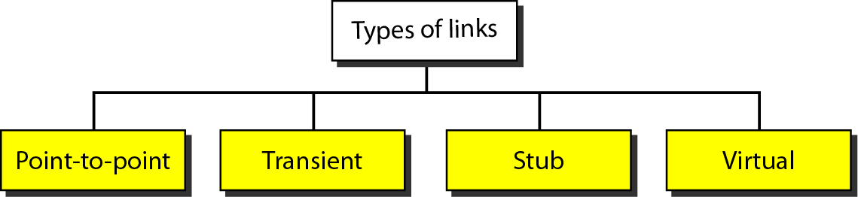
OSPF
In OSPF terminology, a connection is called a link
It has 4 types

Slide 147
OSPF
Point-to-point
  A point-to-point link connects two routers without any other host or router in between
A transient link
  It is a network with several routers attached to it
A stub link
  It is a network that is connected to only one router
Virtual Link
  When the link between two routers is broken, the administration may create a virtual link between them

Slide 148
Outline
Types of Messages
Error Reporting
Query
Message Format

Slide 149
ICMP (Internet Control Message Protocol)
IP protocol has two deficiencies
  Lack of error control
  Lack of assistance mechanisms
ICMP has been designed to compensate for the above two deficiencies

Slide 150
Types of Messages
Error-reporting messages
  It report problems that a router or a host may encounter when it processes an IP packet
Query messages
  It helps a host or a network manager get specific information from a router or another host

Slide 151
Error Reporting
One of the main responsibilities of ICMP is to report errors
Although technology has produced increasingly reliable transmission media, errors still exist and must be handled
ICMP does not correct errors-it simply reports them
Error messages are always sent to the original source

Slide 152
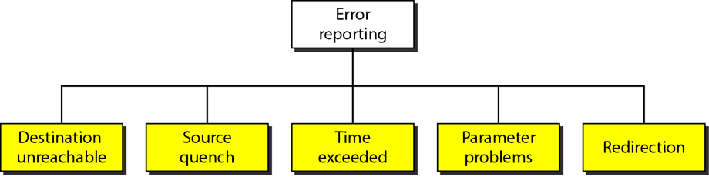
Error Reporting

Slide 153
Error Reporting
Destination Unreachable
Source Quench
  It was designed to add a kind of flow control to the IP
  When a router or host discards a datagram due to congestion, it sends a source-quench message to the sender
Time Exceeded
  A packet can travel in a loop or a cycle (Looping Problem)
  When not all fragments that make up a message arrive at the destination host within a certain time limit

Slide 154
Error Reporting
Parameter Problem
  A router or the destination host discovers an ambiguous or missing value in any field of the datagram
  It discards the datagram and sends a parameter-problem message back to the source

Slide 155
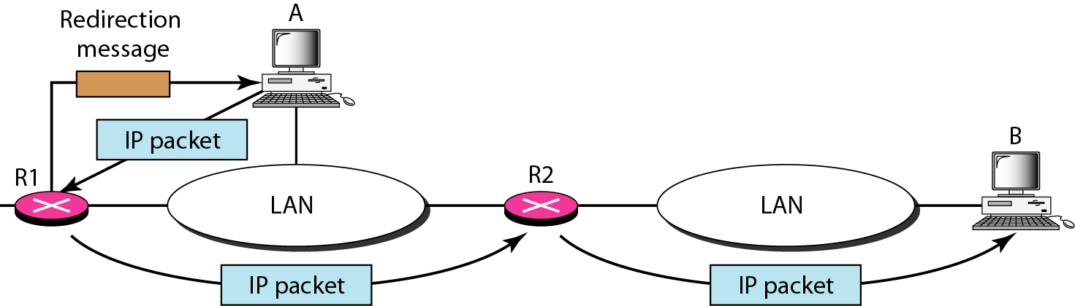
Error Reporting
Redirection
  For efficiency, hosts do not take part in the routing update process
  There are many more hosts in an internet than routers

Slide 156
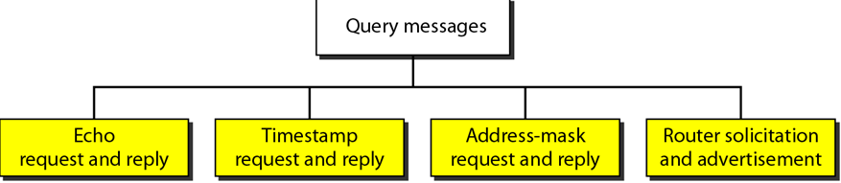
Query
A node sends a message that is answered in a specific format by the destination node
A query message is encapsulated in an IP packet

Slide 157
Query
Echo Request and Reply
  These messages determines whether two systems can communicate with each other
Timestamp Request and Reply
  Hosts or routers can use it to determine the round-trip time needed for an IP datagram to travel between them
  It can also be used to synchronize the clocks in two machines

Slide 158
Query
Address-Mask Request and Reply
  To obtain its mask, a host sends an address-mask-request message to a router on the LAN
Router Solicitation and Advertisement
Checksum
  In ICMP the checksum is calculated over the entire message

Slide 159

Message Format
An ICMP message has an 8-byte header
Although the general format of the header is different for each message type, the first 4 bytes are common to all

Slide 160
Message Format
The first field, ICMP type, defines the type of the message
The code field specifies the reason for the particular message type
The last common field is the checksum field
The rest of the header is specific for each message type

Slide 161
BGP (Border Gateway Protocol)
BGP is an inter domain routing protocol using path vector routing

Slide 162
Outline
Types of Autonomous Systems
Path Attributes
BGP Sessions
External and Internal BGP

Slide 163
Types of Autonomous Systems
Stub
  A stub AS has only one connection to another AS
    Ex: A small corporation or a small local ISP
Multihomed
  A multihomed AS has more than one connection to other ASs, but it is still only a source or sink for data traffic
    Ex: A large corporation that is connected to more than one regional or national AS that does not allow transient traffic
Transit
  A transit AS is a multihomed AS that also allows transient traffic
    Ex: National and international ISPs

Slide 164
Path Attributes
The path was presented as a list of autonomous systems (list of attributes)
Attributes are divided into two broad categories
  Well known
    A well known attribute is one that every BGP router must recognize
  Optional
    An optional attribute is one that needs not be recognized by every router

Slide 165
Well-known attributes
Mandatory
  It is one that must appear in the description of a route
    EX: NEXT-HOP, which defines the next router to which the data packet should be sent
Discretionary
  It is one that must be recognized by each router

Slide 166
Optional Attributes
Transitive
  It is one that must be discarded if the receiving router has not implemented it
Nontransitive
  It is one that must be passed to the next router by the router that has not implemented this attribute

Slide 167
BGP Sessions
A session is a connection that is established between two BGP routers only for the sake of exchanging routing information
BGP sessions are sometimes referred to as semi pennanent connections because it uses service of TCP
BGP can have two types of sessions:
  External BGP (E-BGP)
  Internal BGP (I-BGP)

Slide 168
External and Internal BGP
The E-BGP session is used to exchange information between two speaker nodes belonging to two different autonomous systems
The I-BGP session, on the other hand, is used to exchange routing information between two routers inside an autonomous system

Slide 169
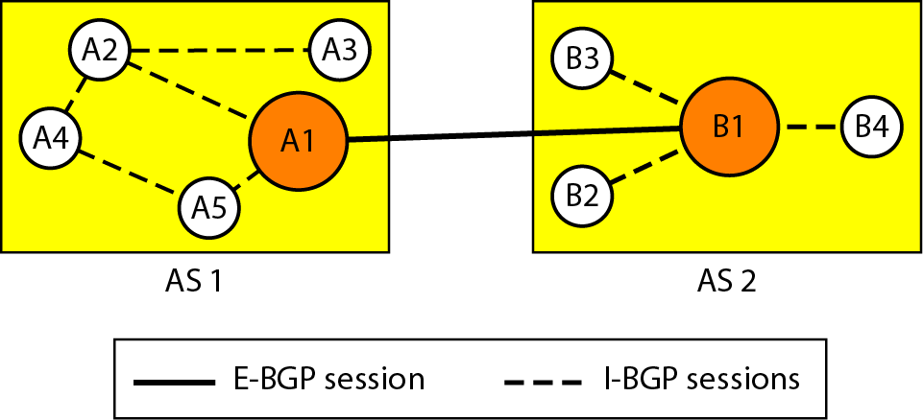
External and Internal BGP

